Slide 1
SSB: Smart Speed Breaker
Team members: Guide : Mima Manual
Abhay P A
Akshay K N
Jishnu N V
Yaswanth P S

Slide 2
Contents
Introduction
Design Phase
Project Objective
High Level Design
Use Case Diagram
Use Case Specification
Conclusion
References

Slide 3
Introduction
The problem faced in traffic by the traffic police and people has inspired the idea of SSB.
It is not just the speed breaker but a kind of automated traffic control system.
SSB is the product aimed to solve problems of systems like:
Speed bump
Speed table
Speed cushion
Actibump

Slide 4
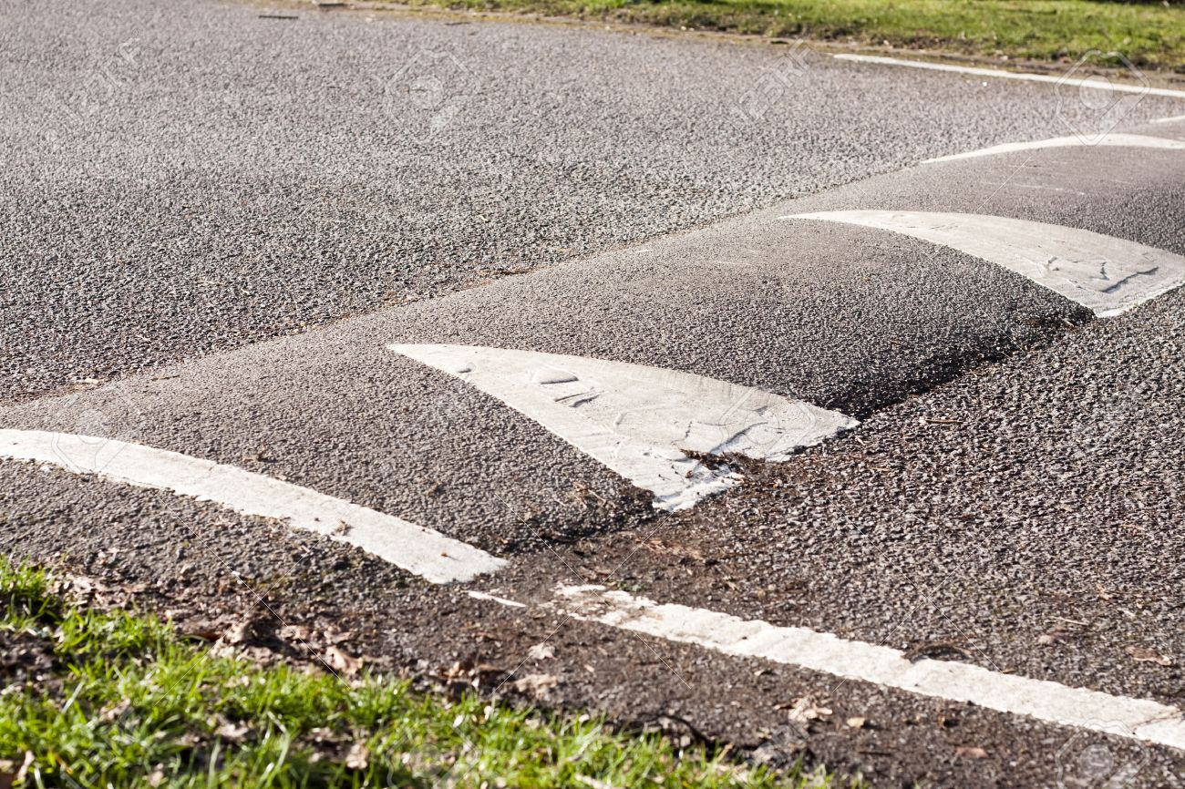
SPEED BUMB
Speed bumps (or speed breakers) are the common name for a family of traffic calmingdevices that use vertical deflection to slow motor-vehicle traffic in order to improve safety conditions. .

Slide 5
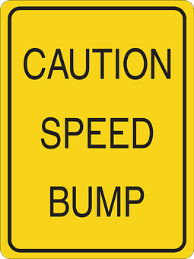
Pros
Reduces speed.
Diverts traffic to another streets, which is positive if the traffic is diverted from a local to a collector arterial street.
Speed and volume changes tend to remain over time.

Slide 6
PROS
Potential to reduce accident rates.
Fewer citizen complaints.
Increased safety.
Residents usually report that they are effective and generally support them.

Slide 7
Cons
May divert traffic to other local streets thus moving the problem.
Large trucks, buses and emergency vehicles must pass over the humps at a low speed or risk possible loss of control.
Humps require signing and striping; some residents object to these signs and markings as unattractive.
Noise levels increase at the hump due to deceleration/acceleration and the noise of a vehicle going over the humps.

Slide 8
CONS
Gutter running (swerving off road into gutter or sidewalk to avoid hump with some tires.)
Potential vehicle damage if traversed at high speeds.
Longer emergency vehicle response times possible.
Additional program to administer.
Initial construction and continuing maintenance costs.

Slide 9
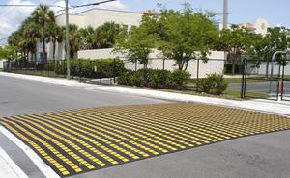
SPEED TABLE
Speed tables are midblock traffic calming devices that raise the entire wheelbase of a vehicle to reduce its traffic speed.
Speed tables may be used on collector streets and/or transit and emergency response routes.

Slide 10
Pros and Cons
Pros
Applicable to 2 way streets.
Relatively easy to maintaine
Cons
Speed tables should not be applied on streets wider than 50 feet.
Comparitively costly than speed bumps.

Slide 11
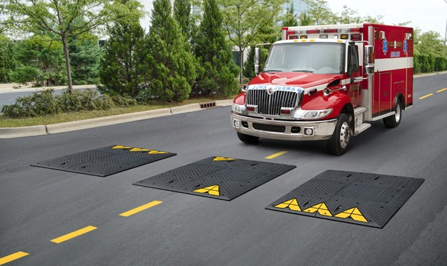
SPEED CUSHION
A speed cushion is a short, raised, rounded device, normally in the centre of a road lane.
Designed to be slightly wider than a car, so car drivers need to slow down.
Buses are wider than cars, so they can drive over speed cushions without passengers feeling anything.

Slide 12
Pros
Buses don't need to slow down
More effective than horizontal treatments at reducing speed
Emergency vehicles can travel drive more quickly over cushions than speed humps or tables
Can be avoided by cyclists
Drainage should not be affected

Slide 13
Cons
Cars drive considerably faster over speed cushions than speed humps or speed tables.
Bus companies and emergency services may oppose wider speed cushions (e.g. 1.7m wide) which are proven to be more effective at slowing down cars.
Some traffic is likely to transfer onto alternative routes, potentially causing a problem somewhere

Slide 14

ACTIBUMP
Actibump is a traffic safety system where speeding vehicles activate an inverted speed bumpintegrated into the road surface.

Slide 15
Pros
Automated system.
Only vehicles travelling above speed limit has to slow down.
Doesn't affect slow vehicles, lower count of deceleration.
Make people follow rules unconsciously.

Slide 16
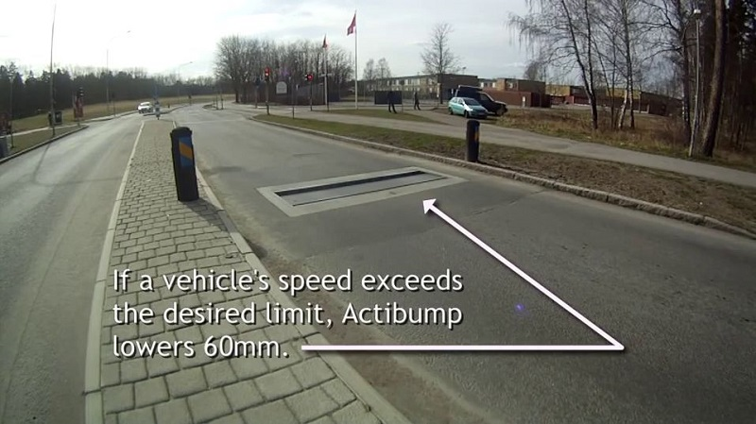
Cons
Higher initial cost.
No consideration for emergency vehicles.
Comparitively difficult to maintain.
Applicable only to oneway roads.
Two wheelers could easly pass over this.

Slide 17
Design Phase
Problem statement: Controlling traffic without affecting vehicles within the speed limit or emergency vehicles.
SSB is an intelligent speed controlling system which is activated only for speeding vehicles,
it will not affect slower vehicles or emergency vehicles

Slide 18
Project Objective
Automatic activating speed hump based on speed of vehicles approaching to control the traffic.
Emergency vehicle detection and avoiding them from speed humps. This help to reduce time consumption and will be life saving.
To make a proper notification system and avoid accidents.

Slide 19
High level design
Block diagram
SSB
Arduino
module
Sensor
module
Notification
module
Mechanical
module

Slide 20
High level design
SSB mainly consists of four modules
Sensory module
Arduino module
Notification module
Mechanical module

Slide 21
Sensor module
Sensory module mainly consists of two types of sensors:
Camera : To capture images of vehicles for emergency vehicle detection.
Ultra sonic sensor : To detect the speed of vehicles for speed detection .

Slide 22
Arduino module
Arduino module accepts the data from the sensory module.
It compares the value with the ideal value and send signals to notification module as well as mechanical module to activate them.
Checks whether the speed is above the speed limit, if so activate SSB
Compares the image of vehicles to detect the incoming emergency vehicles and to deactivate SSB for smooth travel

Slide 23
Notification module
Notification module ensures drivers get proper notifications .
Blinking yellow light to mark the presence of SSB. So that vehicles could slow down.
Red light will warn about the activated SSB.

Slide 24
Mechanical module
Mechanical modules consists of mechanical parts of SSB.
It consists of gears, which is to be rotated according to the signals from arduino to activate SSB.
Motors are placed which will rotate the gears according to the signals.

Slide 25
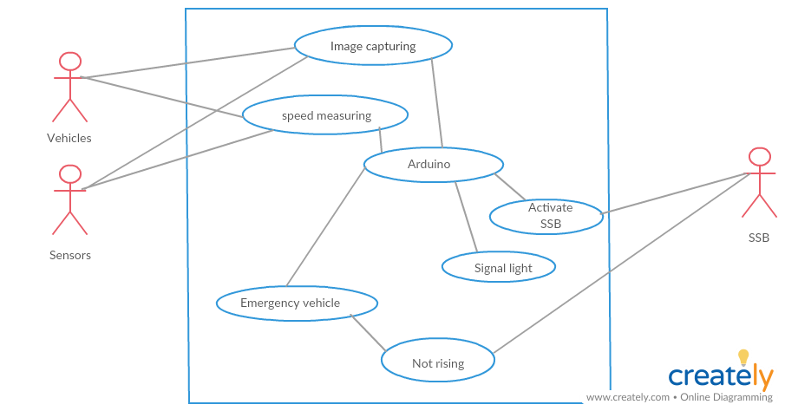
Use Case Diagram
<<include>>
<<include>>

Slide 26
Use Case Specification
Use case ID : UC1.
Use case name: Image capturing.
Description : Images of vehicles are captured through camera and are used by arduino module for recognising emergency vehicles.
Assumptions : Images are captured when vehicles move before the camera and are always inputed to arduino for comparison.

Slide 27
Actors : Vehicles, sensors
Flow of events : Speed vehicles are captured by sensors and send to arduino module.
Pre-conditons : Capture images of vehicles.
Post-conditions : Always send image to arduino for processing.

Slide 28
Use case ID : UC2
Use case name : Speed measuring
Description : Speed of vehicles are measured and send to arduino for processing.
Assumptions : Speed of vehicles are measured and send to comparison.

Slide 29
Actors : Vehicles, sensors
Flow of events : The speed of vehicles are detected by ultra sonic sensors and the value is inputted to arduino.
Pre-conditons : speed of all vehicles are computed.
Post-conditions : send for comparison.

Slide 30
Use case ID : UC3
Use case name : Arduino
Description : Readings from sensors reach here. Image recoginization and speed comparison are done here.
Assumptions : Signals to activat the SSB are send only when speed is above the limit.

Slide 31
Actors :
Flow of events : If the image recoginised are emergency vehicles send to use case emergency vehicle else if speed is above limit signals are send for activating SSB.
Pre-conditons :Signals from camera should reach first then signals from ultra sonic sencors.
Post-conditions : If the values are above the saved values activate SSB.

Slide 32
Use case ID : UC4
Use case name : emergency vehicle.
Description : If the image recoginised to be emergency vehicle SSB should not be activated.
Assumptions : Activated when image is emergency vehicle.

Slide 33
Actors :
Flow of events : When the vehicles identified as emergency vehicle signals send to not activate SSB
Pre-conditons : Signals about emergency vehicle.
Post-conditions : Don’t activate SSB.

Slide 34
Use case ID : UC5
Use case name : Activate SSB
Description : Send signal to rise SSB when the speed is more.
Assumptions : Can only send activating signal when the speed is above the limit.

Slide 35
Actors : SSB
Flow of events : Receive signal from arduino and send signal to rise SSB.
Pre-conditons : work when signal is received from arduino.
Post-conditions : Send signals to activate SSB

Slide 36
Use case ID : UC6
Use case name : Signal light
Description : gives warning to approaching drivers about the presence of SSB and whether it is active or not.
Assumptions : Signal yellow light to indicate the presence, signal red when it is activated.

Slide 37
Actors : SSB
Flow of events : Signal the yellow light always to indicate its presence. Turns red when SSB is activated.
Pre-conditons : Always blink in yellow light to mark its presence.
Post-conditions : Turn red when SSB is activated by arduino.

Slide 38
Conclusion
Our prototype design of SSB is reliable in controlling the traffic in a smart way thus preventing stress for people and traffic police. In this project, we have introduced a model using affordable infrastructure and easy to use applications which, if implemented on a large scale can help us to prevent accidents and enable road safety

Slide 39
REFERENCES

